Slide 1
Tutorial 03 Fundamentals of Artificial Intelligence
Hualie Jiang

Slide 2
Problem 1
1. Answer the following questions:
In Lecture 4, we have learned from best-first search → greedy best-first search → A* search. Please compare their differences.
(d) What is an admissible heuristic? (L4: P20)

Slide 3
Problem 1
best-first search | greedy best-first search | A* search
Evaluation function | Heuristic function | Path Cost + Heuristic function
Heuristic function h(n) is the estimated cost of the cheapest path from node n to a goal state

Slide 4
Problem 1
best-first search
uniform cost search if evaluation function = path cost
greedy best-first search
Similar to depth-first search
Not optimal: just the closest goal is found
Incomplete: repeated states may happen, causing the solution never be found
The time and space complexities: depends on the quality of the heuristic function h
A* search
Complete as uniform-cost search
Optimality can only be assured when h(n) is admissible, i.e. never overestimates the cost from n to reach the goal

Slide 5
Problem 1
1. Answer the following questions:
(b) How to understand the heuristic functions of 8-puzzle, h1 and h2? (L4: P22-23)
(c) What relationship between heuristic functions, h1 and h2? (L4: P25-26)
(e) How to generate admissible heuristic functions? (L4: P28-30)
(f) What is a local maxima? (L4: P39)

Slide 6
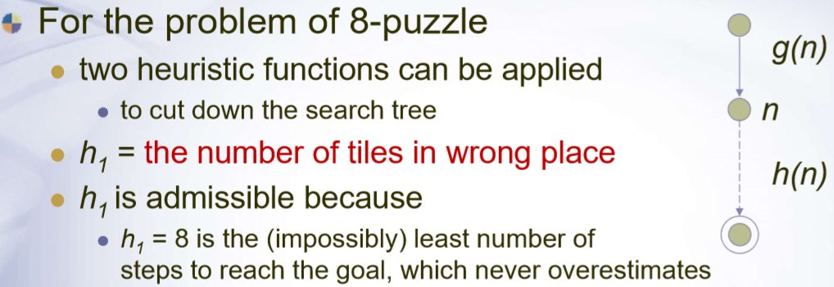
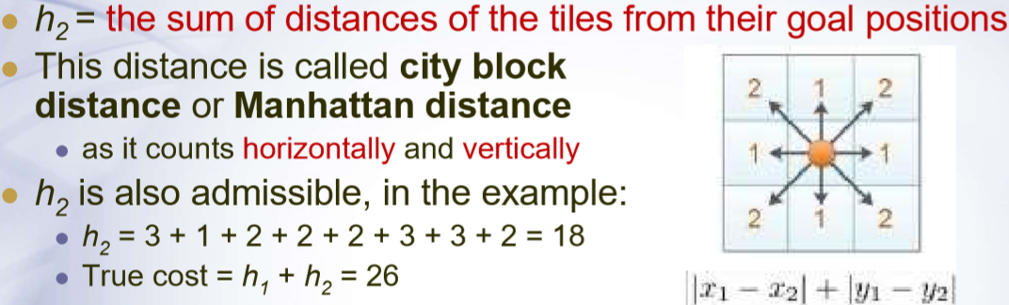
Understanding h1 and h2 of 8-puzzle

Slide 7
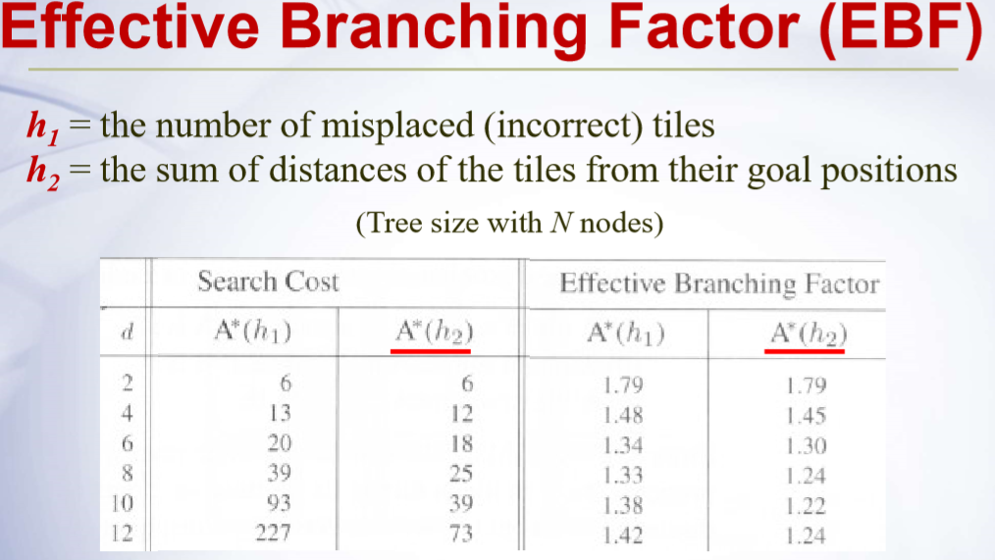
Understanding h1 and h2 of 8-puzzle

Slide 8
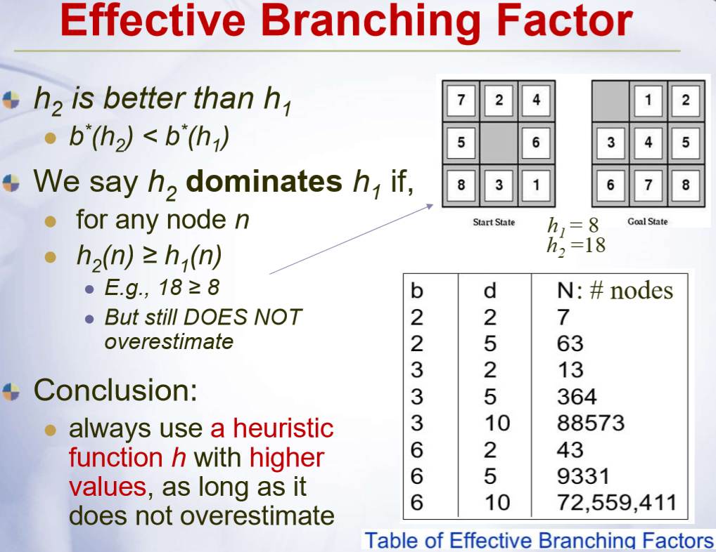
Understanding h1 and h2 of 8-puzzle

Slide 9
Generation of Admissible Heuristic Functions
Heuristic Functions: estimated cost of the cheapest path from node n to a goal state.
h(n) is admissible:
never overestimates the cost from n to reach the goal
If we overestimate the cost, the searching path may not be reached
Relaxed problem:
A problem with less restriction on the operators
The cost of an exact solution to a relaxed problem is a good heuristic

Slide 10
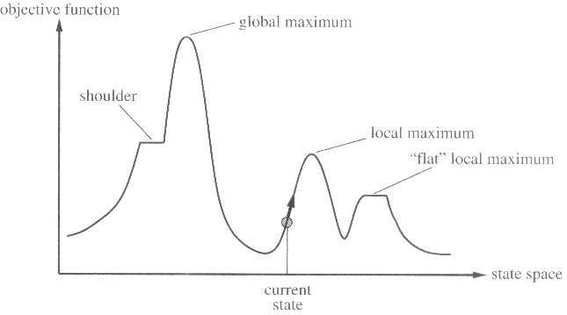
The Local Maxima

Slide 11
Problem 2
2. Three functions, including g(n) in Lecture 3 and both f(n) and h(n) in Lecture 4, have been defined to evaluate the search algorithms. Please explain their difference.
g(n) -- path cost -- uniform cost search
f(n) -- the evaluation function -- best first search
h(n) -- the heuristic function -- greedy best-first search

Slide 12
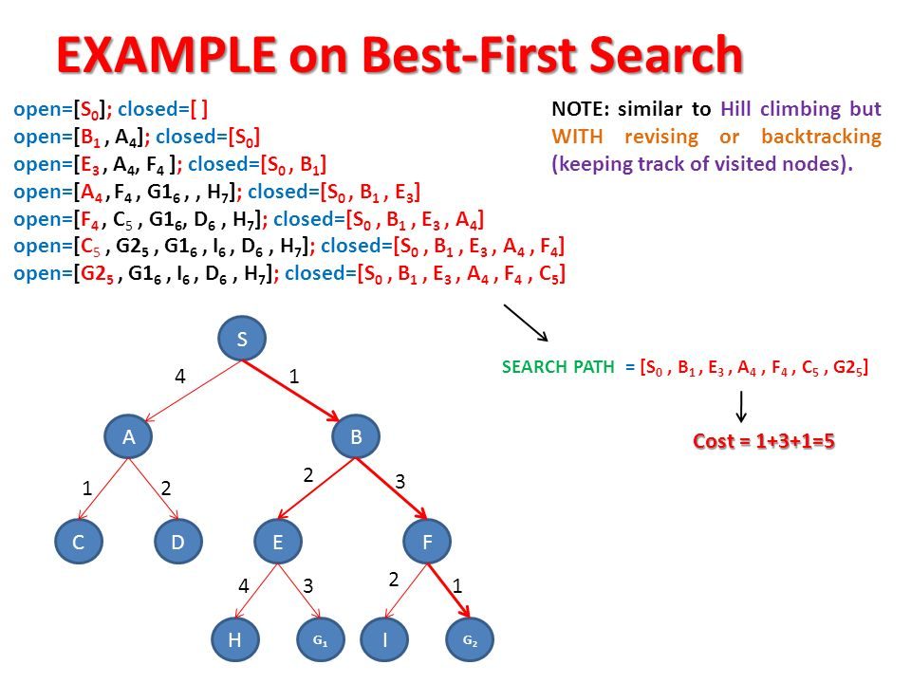
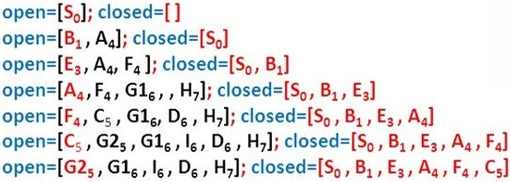
Problem 3
3. Informed search uses only best-first search. Please understand the following example about its search path and cost.

Slide 13
Problem 4
4. Consider a search tree with the cost of every step exceeds some small positive constant ε. Check the completeness and optimality of the following search algorithms with T(true) and F(false). What are the conditions for the optimality of BFS, IDS and A*S?
 | BFS | UCS | DFS | IDS | GBFS | A*S
Completeness
Optimality | T’ |  |  | T’ |  | T’
BFS: breadth-first search; UCS: uniform-cost search; DFS: depth-first search; IDS: iterative deepening search; GBFS: greedy best-first search; A*S: A* search; T’: true, subject to some condition.

Slide 14
Problem 4
 | BFS | UCS | DFS | IDS | GBFS | A*S
Completeness | T | T | F | T | F | T
Optimality | T’ | T | F | T’ | F | T’
BFS is optimal provided that all the step costs are the same.
IDS is optimal provided that all the step costs are the same.
A*S is optimal provided that h(n) is admissible.

Slide 15
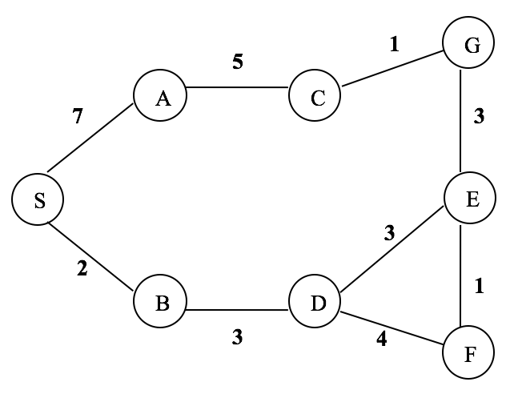
Problem 5
5. Use A* search to search the following graph (S: starting state, G: goal state). h(n) is the estimated distance to the goal. What is the order of the expanded nodes? (L4: P15)
 | S | A | B | C | D | E | F | G
h(n) | 10 | 5 | 8 | 1 | 4 | 2 | 3 | 0
Order: S,B,D,E,G

Slide 16
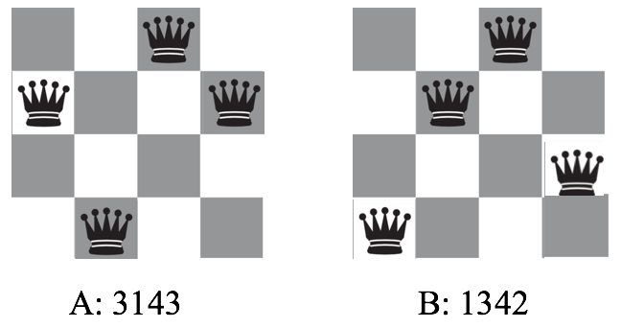
Problem 6
6. Use genetic algorithm to solve the 4-queens problem. Suppose two of the initial population are A(3143) and B(1342). The definition of the fitness function is: the number of non-attacking pairs of queens. (L4: P54)
(a) Calculate the fitness of A and B.
(b) If A and B is a pair to be mated and the crossover point is after the first digit, what are the offspring (A’ and B’) after crossover?
(c) What is the mutation result if the last digits of both A’ and B’ are mutated to the value of 1?

Slide 17
Calculation of the fitness of A and B
fitness(A)=3, fitness(B)=5

Slide 18
Crossover
A’=3342, B’=1143

Slide 19
Mutation
A’’=3341, B’’=1141

